Slide 1
Financial - Analysis: CTSH
Team 3
Amit Sharma, 0794488
Suhail Ahmed, 0789949
Rajvi Mehta, 0788372
Harshil Patel, 0791261
Jayraj Radadiya, 0789984

Slide 2
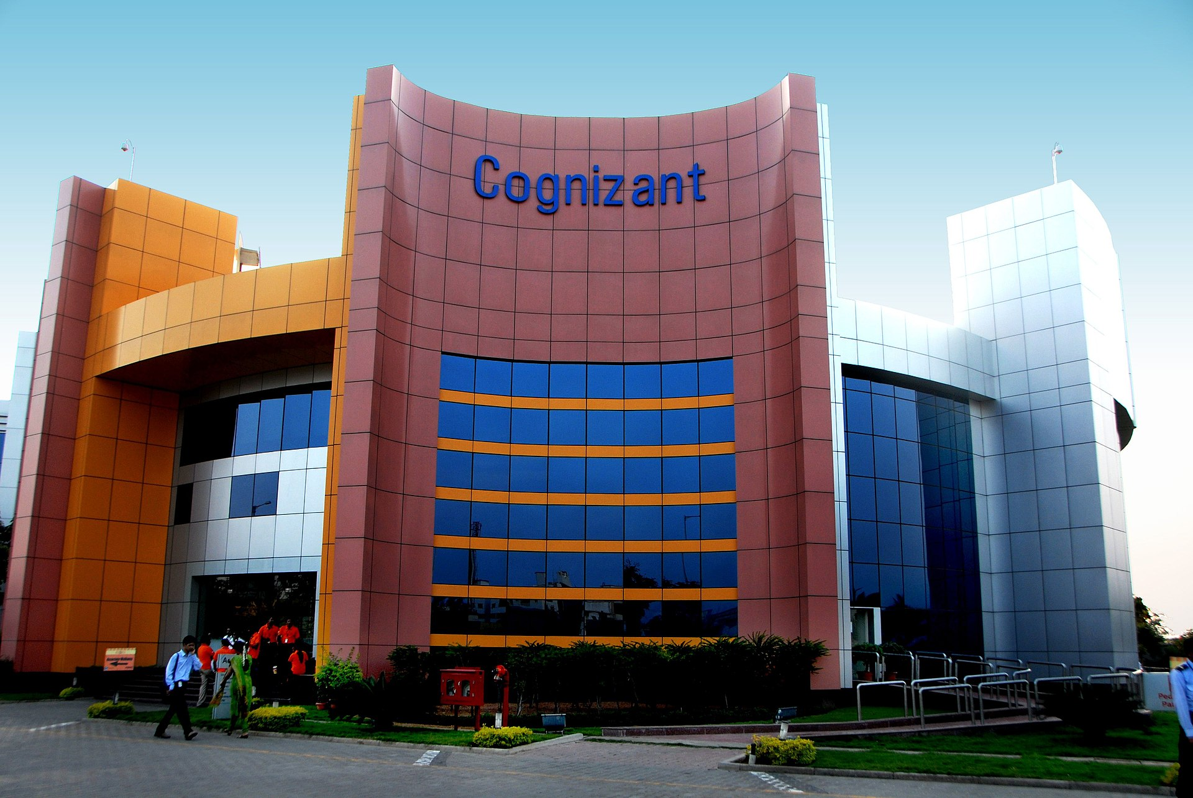

Goal
The goal is to predict the future performance of a stock using a combination of financial models and analysis techniques such as Capital Asset Pricing Model (CAPM), Dividend Growth Model, Facebook Prophet, Bollinger Bands, Financial Ratios, and Monte Carlo Analysis.
The objective is to estimate the expected return and level of risk associated with the stock based on various market factors and historical data. The purpose of this analysis is to assist investors in making informed decisions about whether to buy, hold, or sell the stock.

Slide 3
Cognizant Technology Solutions - CTSH
Employees worldwide
Total revenue
2022 Fortune 500 ranking
355,300
$19.4B
#194
Cognizant Technology Solutions was founded in 1994 in the United States and initially focused on providing technology development and support services to its clients. The company grew rapidly in the late 1990s and early 2000s, expanding its operations to India in 1996 and becoming a public company in 1998 when it was listed on the NASDAQ stock exchange. Over the years, Cognizant has expanded its service offerings to include digital, technology, consulting, and operations services. The company has a global workforce of over 300,000 employees, serving clients in more than 40 countries. In recent years, Cognizant has been investing heavily in innovation and expanding its digital capabilities to better serve its clients in the evolving digital landscape. (Source: Cognizant.com)
1
2
The current macroeconomic environment and business cycle are favorable for Cognizant's business. The global economy is recovering from the COVID-19 pandemic, and the business cycle is in the expansion phase, leading to increased demand for digital transformation and technology services. Cognizant's ability to adapt and innovate has been key to its success in this challenging environment. (Source: McKinsey & Company)
The IT industry environment is highly competitive, with numerous players competing for market share. Some of Cognizant's top competitors include Accenture, Tata Consultancy Services, IBM, Infosys, and Wipro. As of 2021, Cognizant had a market share of approximately 4.6%, trailing behind Accenture and TCS, which had market shares of 9.4% and 8.6%, respectively, according to Statista. (Source: Statista)
3

Slide 4
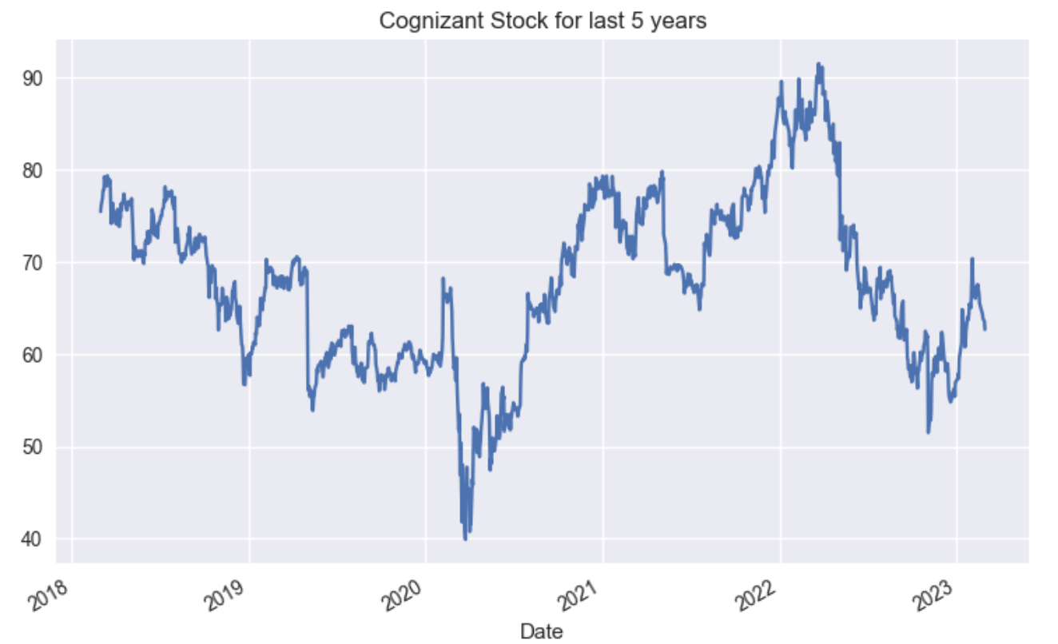
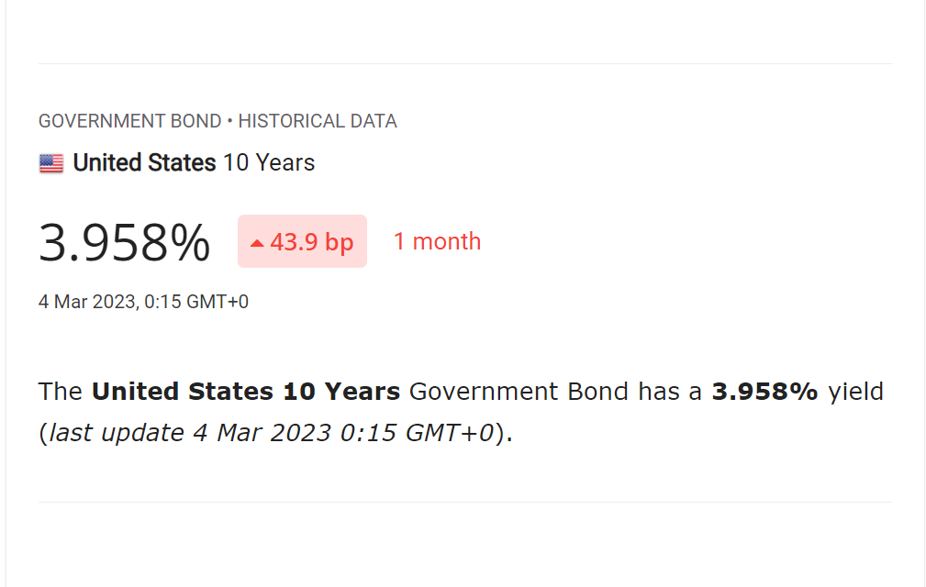
Cognizant (CTSH) – Valuation - CAPM & Dividend Growth
CAPM
Using the CAPM, value of r (the expected return on the asset) comes out as 9.417%; with a calculated Beta value as 1.1035 (Yahoo value for Beta is 1.11 as on 7/4/2023).
r = rf + β(rm - rf)
Dividend Growth Model
Expected return on asset (r) = 9.417%
Earnings Per Share = $ 4.42
Payout Ratio = 24.67%
Dividend per share(DS)=Earnings per Share*Payout Ratio=$ 1.089
Dividend growth rate (g) = 7.9%
Value = $ 71.715
Value = DS / (r - g)
Dividend Growth Model is used to estimate the intrinsic value of a stock based on its future dividends.
A 9.417% growth rate is considered moderate to high rate of growth, it is generally seen as a positive sign for investors, as it suggests that the company is performing well and has a good outlook for the future.

Slide 5
Ratios
liquidity ratios
Current Ratio: 2.17 – Industry between 1.5 and 3 – so good
Quick Ratio: 1.42 – have cash assets to pay current liabilities so good
Cash Ratio: 1.40 – CTSH being service industry have minimal inventory so very similar Quick and Cash ratios – again good
Profitability ratios
Gross Profit Margin: 35.93% -
Operating profit margin: 15.28% - Range for industry is 5 to 20%, CTSH is well placed here
Return on assets: 12.83% -
Return on equity: 18.60% -
Return on sales: 15% - Better than 82% of the companies in the sector
Return on Investment: 18.40%
Debt to Equity Ratio: 5.35%
Price to Earning Ratios : 14.01
Dividend payout ratio: 25.80%
Growth Rate: 4.98%

Slide 6
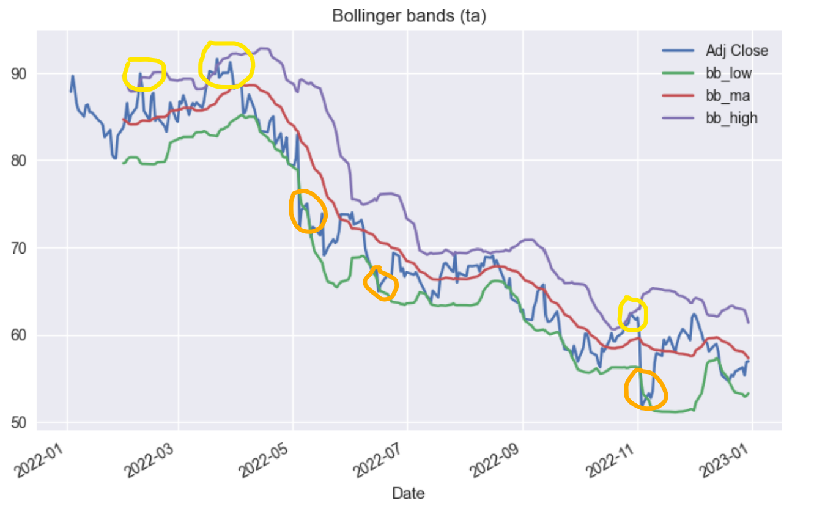
Technical Analysis & Monte Carlo Simulation
Monte Carlo
MonteCarlo simulation done from January 1,2022 through December 31, 2022, and simulated the stock price for January 1,2023 through December 31, 2023 by performing 10,000 simulations
Average Price: $ 56.85
Standard Deviation: 1.2560
Average Return : -0.16%
positive returns: 46.8%
Bollinger Bands
Bollinger Bands identify potential overbought or oversold conditions. When the price of a stock moves above the upper band (Yellow circles), it is considered overbought, and when it moves below the lower band (Orange circles) , it is considered oversold. Investors may use this information to help identify potential trading opportunities, such as selling when the price reaches the upper band and buying when it reaches the lower band. Bollinger Bands also help investors identify potential trend reversals. If the price of a stock is trending up, and it touches or breaks below the lower band, this may signal a potential trend reversal.

Slide 7
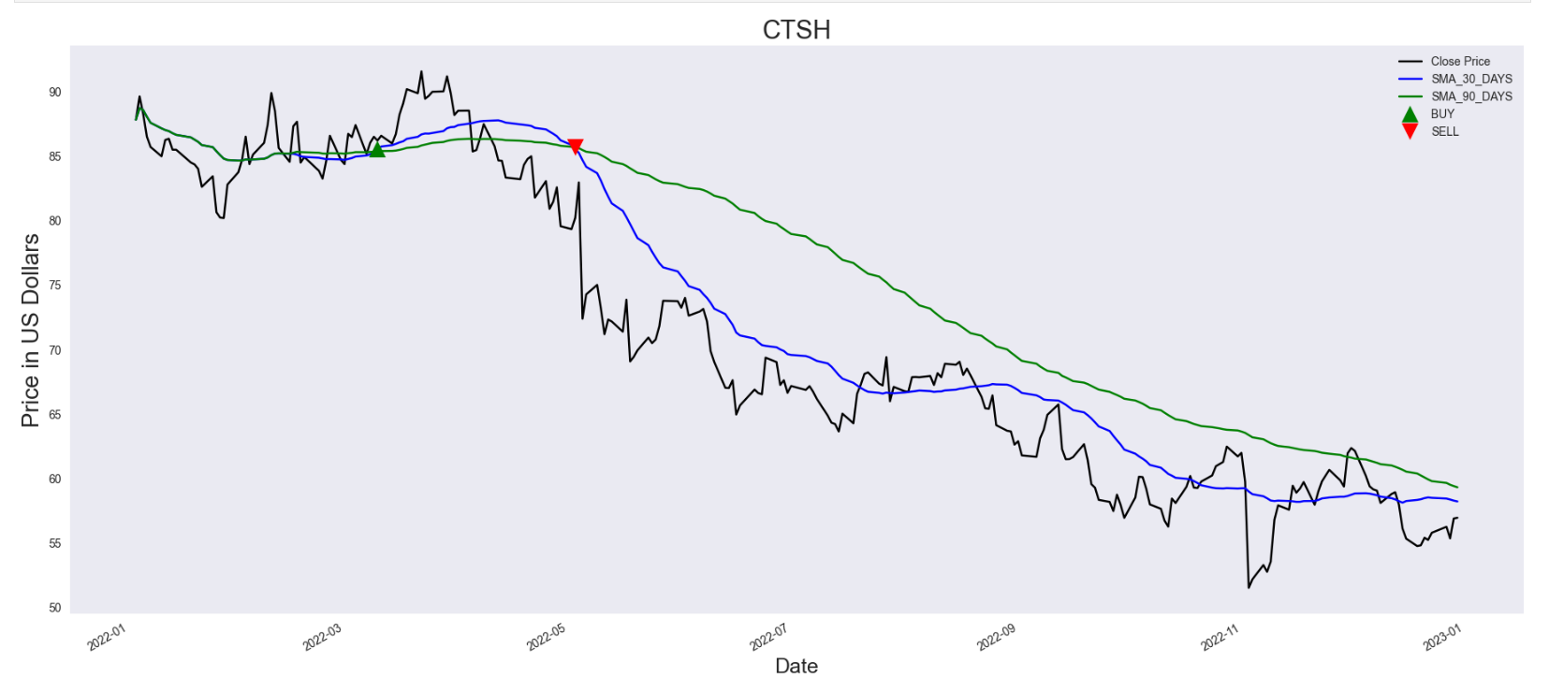
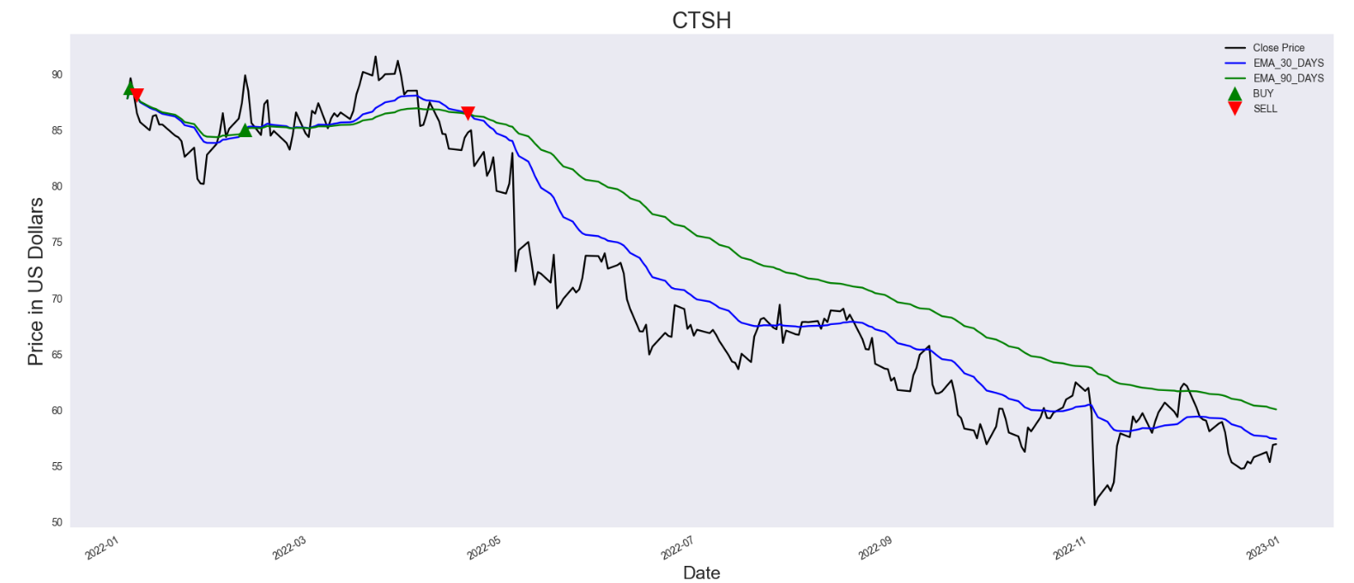
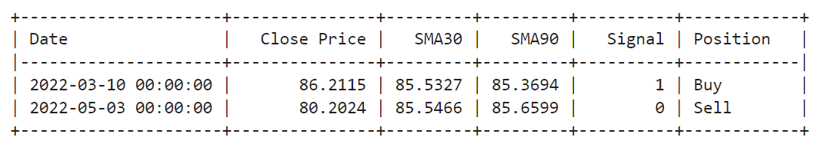
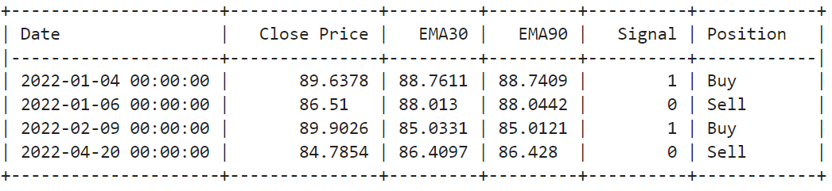
Stock Signals

Slide 8
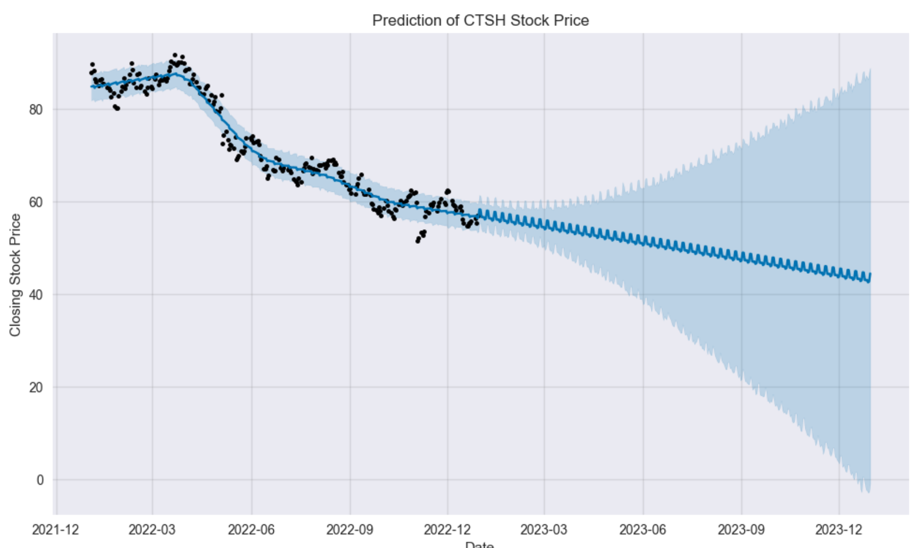
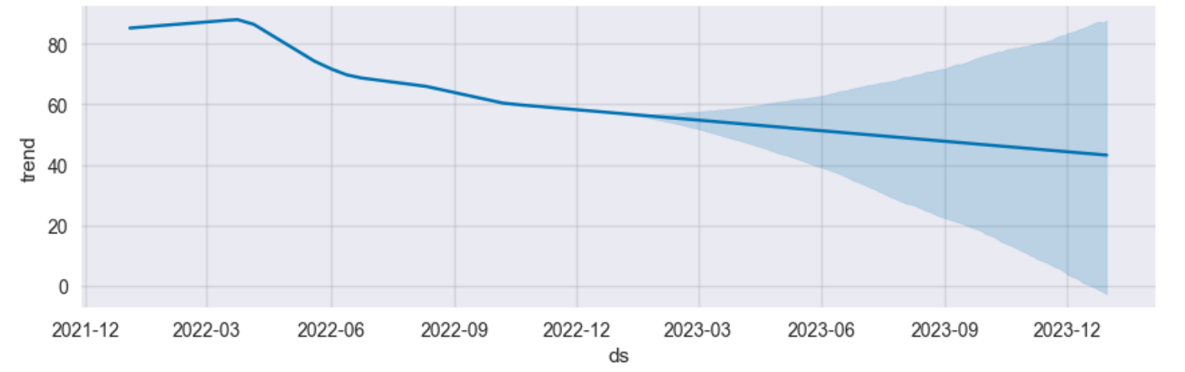
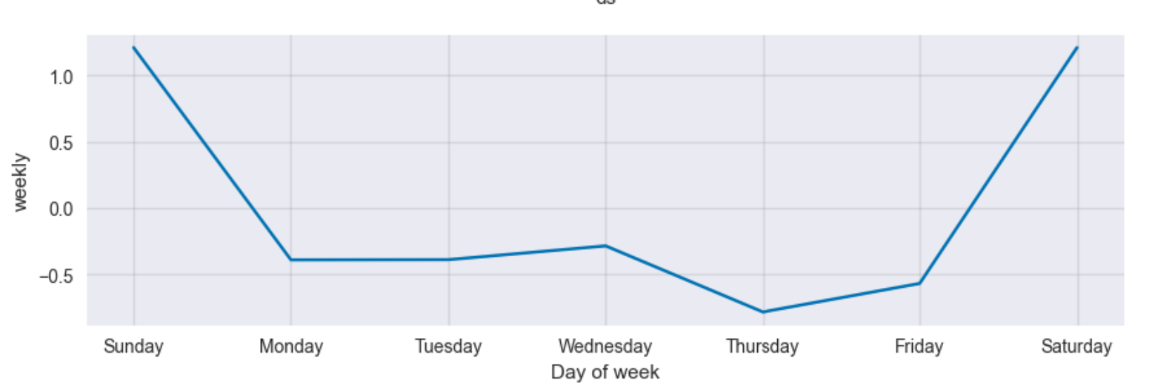
Forecasting – Fb Prophet
Facebook Prophet is a time series forecasting library developed by Facebook's data science team. It can be used to forecast future trends and patterns in time series data, including stock prices. Here's how it can help in stock prediction:
Handling Seasonality
Flexibility
Visualization
Interpretability
It's important to note that while Prophet can be a useful tool for stock prediction, it's not a guaranteed solution for predicting stock prices accurately. Many factors can affect stock prices, including macroeconomic factors, company-specific news, and investor sentiment. As such, Prophet should be used in conjunction with other tools and information when making investment decisions..

Slide 9
Recommendation
The average analyst rating for CTSH stock from 34 stock analysts is "Hold". This means that analysts believe this stock is likely to perform similarly to the overall market.
According to 34 stock analysts, the average 12-month stock price forecast for CTSH stock is $66.7, which predicts an increase of 10.39%. The lowest target is $49.49 and the highest is $95.55. On average, analysts rate CTSH stock as a hold.

Slide 10

References
https://www.cognizant.com/us/en/about-cognizant
https://www.cognizant.com/en_us/about/documents/q4-2022-corporate-overview.pdf
https://www.cognizant.com/en_us/about/documents/q4-2022-corporate-factsheet.pdf
https://seekingalpha.com/article/3784566-cognizant-dominant-player-in-booming-software-service-industry
https://comparable-companies.com/search?domain=https://www.cognizant.com
https://www.nasdaq.com/market-activity/stocks/ctsh/dividend-history
https://corporatefinanceinstitute.com/resources/valuation/dividend-growth-rate/
https://stockanalysis.com/stocks/ctsh/forecast/
http://www.worldgovernmentbonds.com/bond-historical-data/united-states/10-years/

Slide 11
Thank you.

